Slide 1

NAKUJA PROJECT N-2 BENCHMARKING OF ROCKET MODELS.
Benchmarking of rocket models of approx. 1km apogee.

Slide 2

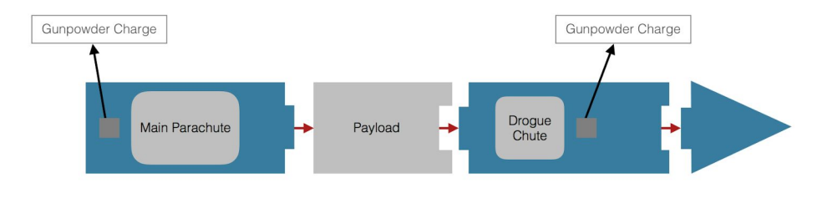
R1: Kill Joy BY Tuskegee university.
Altitude: 1600m
SIZE AND MASS:
Length: 330 cm
Airframe Diameter: 13.21 cm
Span Diameter: 14.92 cm
Mass: 10 kg
Material: Fiberglass
MOTOR CHOICE:
54mm L1400­LW Motor by Loki Research
Max thrust: 2710.5N
COMPARTMENTS:
Nose Cone
Body Tube
Payload/Avionics bay
Motor mount
RECOVERY SYSTEM:
Two parachutes controlled by two independent altimeters.

Slide 3
AIRFRAME:
body tube was manufactured by layering fiberglass onto a waxed mandrel that had epoxy 205 applied to it.
Motor mount consisted of a fiberglass cylinder casing and two bulkheads
The fins, bulkheads, and centering rings were created through compression molding and shaped with the use of a CNC Router
HARDWARE:
PerfectFlite MINIALT/WD; These altimeters control the deployment of the parachute and drogue shoots at the chosen altitudes.
StratoLogger SL­100 Altimeter ; This altimeter serves as a failsafe in case one of the altimeters encounters a disturbance or abnormality during the flight.
Transmitter/Receiver: XBee­PRO XSC S3B with Associated Ground Station Receiver ­ GPS; allows the rocket to send altitude information, payload test data, and GPS location to the ground station.

Slide 4
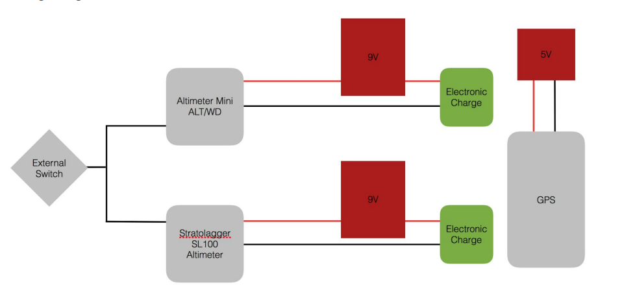
RECOVERY SUBSYSTEM:
consists of a dual parachute arrangement (drogue chute and main cute) that is electronically deployed by two altimeters.
deployed using two independent gunpowder charges that will be triggered by either altimeter.
Drogue chute is placed at the front body tube and is deployed at apogee.
Main parachute is triggered once a pre-determined height is achieved. It’s deployment separates the rear body tube and front body tube – each descending with its own chute.
WIRING DIAGRAM

Slide 5
POWER SUBSYSTEMS:
Eight 9 volt batteries will provide power for the payload components and transmitters.
Both of the altimeters and GPS have independent dedicated power sources
Reference: https://www.tuskegee.edu/Content/Uploads/Tuskegee/files/CriticalDesignReview2009-1.pdf

Slide 6

Thank You!
someone@example.com

